Slide 1


An initiative funded by

Slide 2
Changes Related to Major Recommendations in First Two Reports
Presidential Control and Leadership (mid-90s)
  NCAA governance was restructured to put presidents in control
  Conference governance replicated NCAA presidential control
  Presidential authority on campus increased
Academic Integrity
  Individual eligibility measures strengthened (1990s - present)
    Stronger initial eligibility standards
    Continuing eligibility based on progress toward degree
  Team and institutional accountability measures developed (2004)
    NCAA developed Academic Progress Rate (APR) and Graduation Success Rate (GSR)
    Implementation of Academic Performance Program
Financial Integrity
  Financial controls strengthened (early 90s)
    “All funds raised and spent for athletics will go through the university’s central financial controls.”
    Athletics foundations and booster clubs brought under institution’s direct control.
Notes:
Pt. 1 – Presidents in charge as a Board of Directors; conference structures replicated that approach and presidents more directly involved on campus
Pt. 2
initial eligibility requirements and continuing eligibility based on progress toward degree completion.
Pt 3. NCAA designed Academic Progress Rate (APR and Adopted Academic Performance program to hold teams, coaches and institutions accountable

Slide 3


RESTORING THE BALANCE
Dollars, Values, and the Future of College Sports

Slide 4
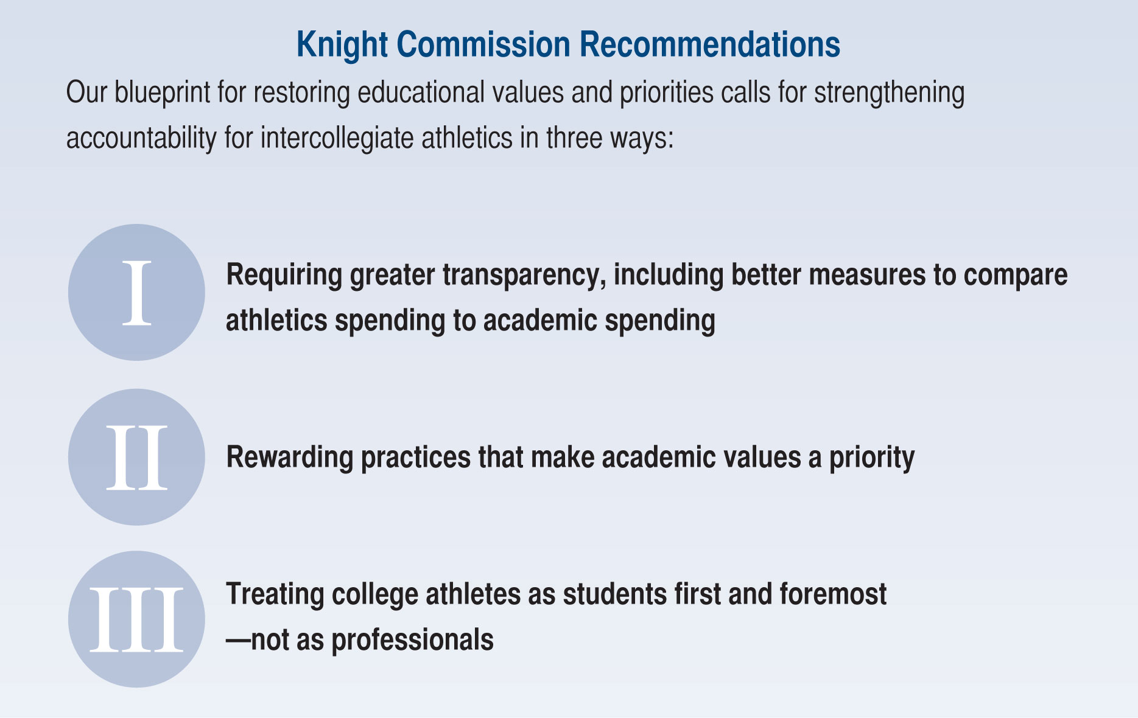

Slide 5
I - Requiring Greater Financial Transparency
Make NCAA financial reports public; include information on long term facilities debt and comparison of annual rates of change in athletic and academic spending
  Results:
    No NCAA action.
    Knight Commission launched Academic and Athletic Spending Database.
Strengthen oversight for financial integrity in NCAA certification, accreditation, and board oversight
  Related Actions:
    NCAA’s new Institutional Performance Program (replaced certification) incorporates fiscal management in assessment.
    Knight Commission provided support for Association of Governing Boards report on board oversight of athletics.

Slide 6
II - Rewarding Practices that Make Academic Values a Priority
Require teams to be on track to graduate 50% of players (930 APR) to be eligible for NCAA championships and football bowl games
  Result: Adopted by the NCAA Board in October, 2011 and phased in; fully implemented by 2015-16.
Provide financial rewards for meeting academic outcomes and for holding athletics spending in check
  Result: Minimal progress. College Football Playoff will allocate $37.5 million of $500 million annual revenues on basis of meeting academic benchmarks.
5
Notes:
5

Slide 7
III - Treating Athletes First and Foremost as Students – Not as Professionals
Limit intrusions on academic responsibilities and prohibit commercial use of college athletes’ identities.
  Related actions:
    Big 5 conferences proposing autonomy to create “athletics dead periods” in new legislative structure.
    Commercial use of college athletes’ identities (e.g., names, images) scrutinized as part of O’Bannon v. NCAA lawsuit.
    Proposed rules changes to allow more commercial use of athletes’ identities were abandoned.
Curb trends toward professionalization of athletics staffing devoted to athletic development
  Related actions: Big 5 conferences proposing autonomy to address limits on non-coaching personnel in new legislative structure.

Slide 8
2013 Knight Commission
Governance Recommendations
More changes are needed to restore integrity to an aspect of university life that is treasured by the American public.
Alter composition of Division I Board of Directors to include independent directors (e.g., former college athletes or professionals with relevant expertise). Broaden to include experts and practitioners in advisory or membership roles.
A portion of the FBS College Football Playoff revenues should reimburse the NCAA for services that enable college football to operate and the funds should directly support athletes’ educational experiences.
Revise revenue distribution to ensure that academic incentives are appropriately embedded in the system.

Slide 9
Overview of Knight Commission’s Work on Division I Finances

Slide 10
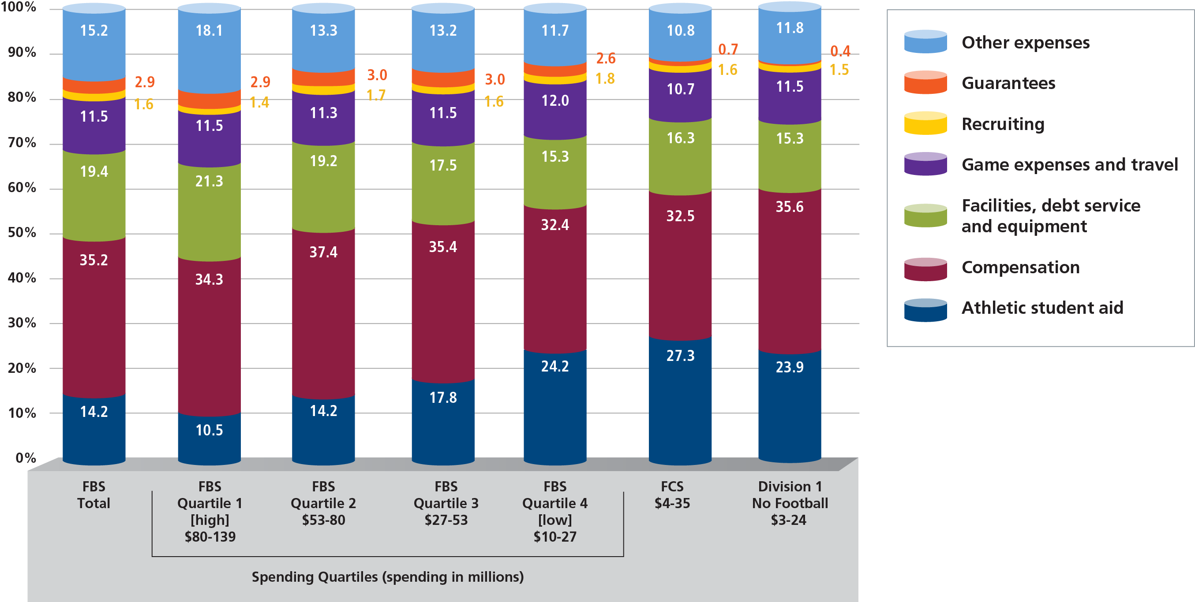
Where the Money Goes...
Distribution of Athletic Expenditures for Division I Institutions, 2012

Slide 11
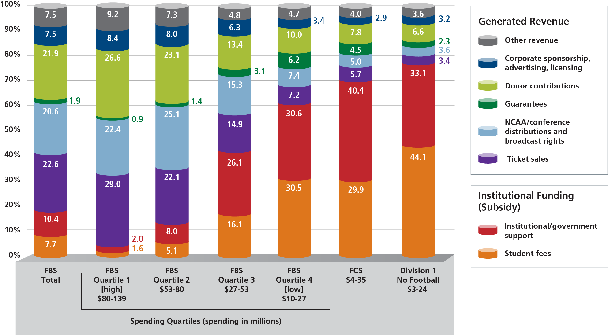
Where the Money Comes From...
Sources of Athletic Budget Revenue for Division I Institutions, 2012

Slide 12
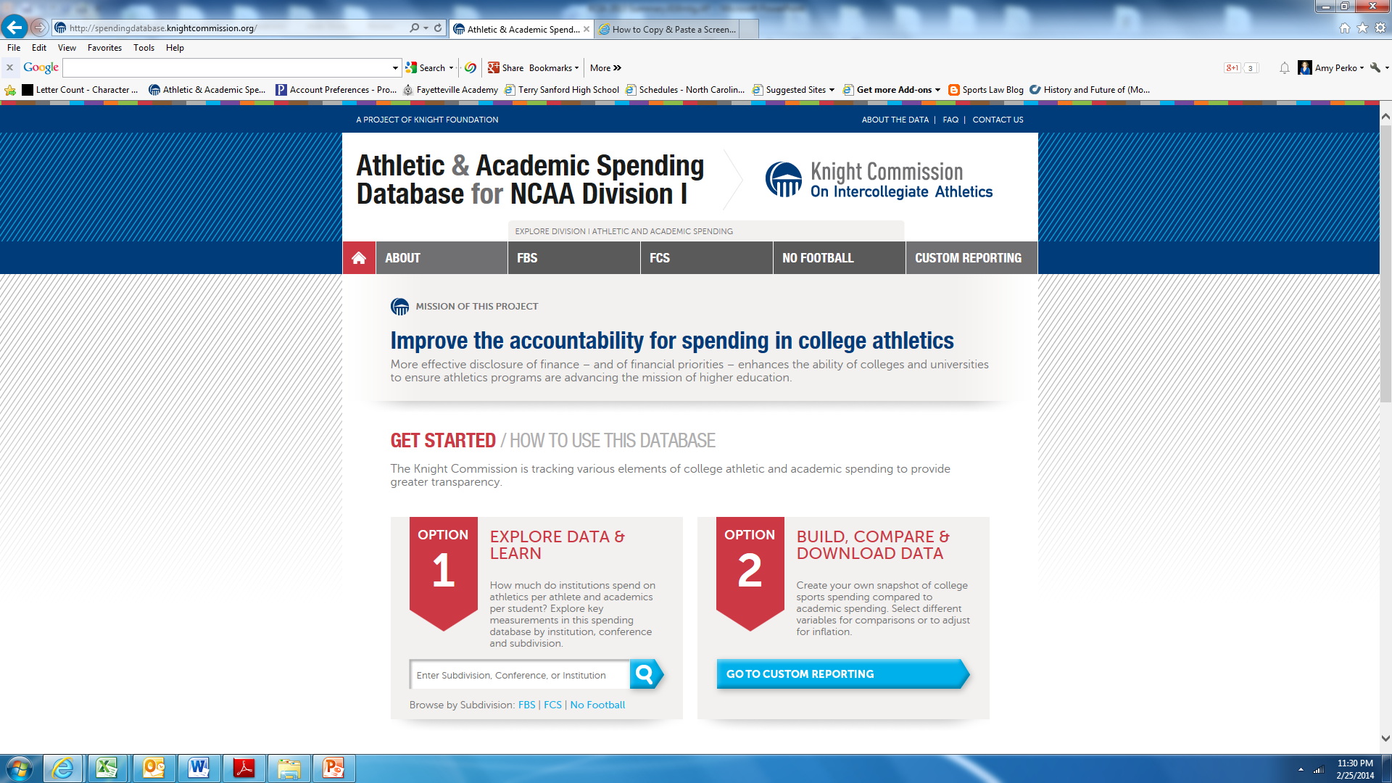

Slide 13
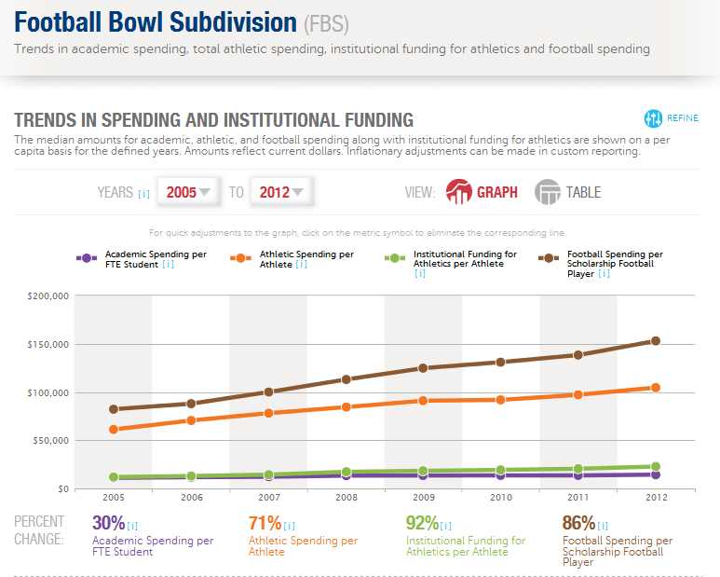


Slide 14
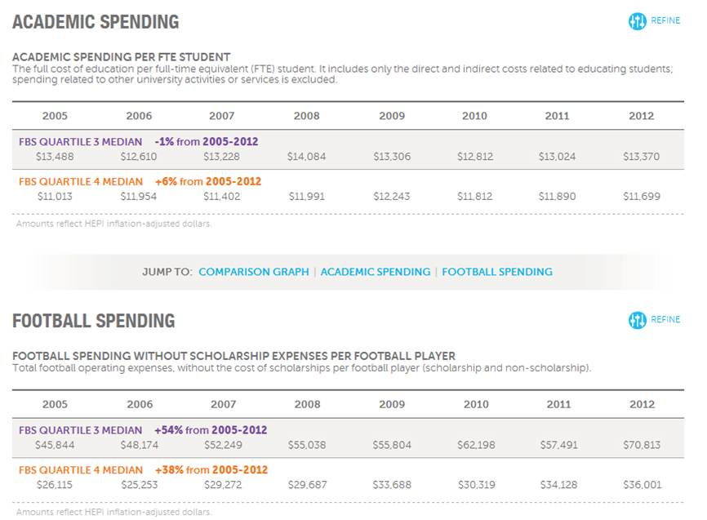

Slide 15










Media Overview: Spending Database Launch
2013 National Coverage
“Knight Commission unveils college sports database”
“College Sports Spending
Is Insane”
“Academics left out of college football’s multibillion-dollar bonanza?”
“New Database Tracks Collegiate Athletic, Academic Spending Per School”

Slide 16











Regional & University Media Coverage
“SEC outspends nation on athletes”
“Disturbing trends as colleges spend even more on athletics”
“Athletic and academic funding changes at MU”
“Knight Commission Database Dissects Athletic Spending”
“Sports Spending Exploding At Northwest Pac-12 Schools”

Slide 17
Editorial Board Coverage
Lexington Herald-Leader
  Athletics are valued over academics at Kentucky colleges
Raleigh News and Observer
  Disturbing trends as colleges spend more on athletics
Greensboro News & Record
  A broken model
Richmond Times-Dispatch
  Today’s top opinion: The Sporting News
Charlotte Observer
  More trouble ahead for college athletics?
Owensborough Messenger-Inquirer
  Colleges must invest more in nonathletes
Red & Black (UGA)
  Our Take: New database could help police athletic funding

