Slide 1
KNIGHT COMMISSION
MEETING
OCTOBER 29, 2018

Slide 2
topics
Organizational Overview
Athlete Protection, SafeSport & Coach Licensing
USAB & Commission on College Basketball

Slide 3
USA BASKETBALL
Colorado Springs, CO…non-profit NGB for basketball in the U.S…Amateur Sports Act of 1978….recognized by FIBA & USOC
Organized in 1974…ABAUSA…prior to ’74, AAU fielded national teams; ‘89 name change to USA Basketball

Slide 4
USA BASKETBALL
Association of associations
FIBA World Ranking: 1

Slide 5
Mission
As the governing body for basketball in the United States, USA Basketball will be a worldwide leader in the sport through athlete protection, competitive excellence in international competition and by promoting, growing and elevating the game at all levels.

Slide 6
USA Basketball ATHLETE PROTECTION, SAFESPORT & COACH LICENSING

Slide 7
ATHLETE PROTECTION & SAFESPORT TIMELINE
2010 USOC launches SafeSport efforts – Olympic Movement’s campaign to bring awareness and appropriate response to abuse in sport- minimum standards developed
2012 USAB adopts USOC SafeSport Guidelines (USAB’s scope only National Team since no Youth Development programs at time;
2015 USAB launches Coach License Program (SafeSport Education is an integral part of the licensing Requirement; differentiates USAB youth program from others)
2016 USAB Coach License program expands (NCAA requires USAB Coach License for summer certification); many SafeSport complaints against NGBs come to light, especially USA Gymnastics

Slide 8
USA BASKETBALL & SAFESPORT
U.S. CENTER FOR SAFESPORT
USA Basketball
National Team Program
Youth Development
SafeSport Education
SafeSport Education
Background Screening
Background Screening
Coach License

Slide 9
USA Basketball Athlete & participant Protection
Mission: To promote, sustain, and encourage institutional accountability for the health, safety and well-being of all USA Basketball Athletes and Participants.
Core Values
Safety and Protection
Teamwork
Integrity
Accountability

Slide 10
U.S. CENTER FOR SafeSport
Classification of Responding Party
Athlete & Responding Party Relationship
18%
Coach-Adult Athlete
Coach-Minor
Athlete
Staff-Athlete
23%
Gender of Responding Party
11%
48%
Athlete-Athlete

Slide 11
U.S. BASKETBALL COMMUNITY

Slide 12
YOUTH DEVELOPMENT
USAB establishes youth development division in 2013
Purpose: Promote, Grow, Elevate
Programs:
Coach Licensing
Coach Academies
Organization Accreditation
E-Learning
Regional Camps
U.S. Open Basketball Championships
3 x 3
Women in the Game
Open Court
Youth Clinics

Slide 13
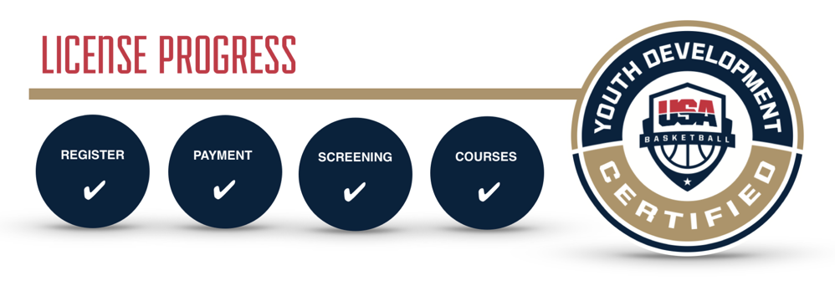
COACH LICENSING
Actively licensed coaches are re-screened automatically each month
Licenses are revoked or suspended upon alerts of disqualifying criteria
Known affiliated organizations are notified of license revocation

Slide 14
Usa basketball
Coach licensing DATA
Youth Development: 2017-18 Season
Licensed Coaches = 26,107
Questionable Background Screens = 3,281
Denied Coaches = 288 (24 submitted to USCS)
Disciplinary Record List
USA Basketball Disciplinary Records List

Slide 15
USA Basketball &
Commission on college basketball

Slide 16
USAB & COMMISSION on cbb
USAB, NCAA, NBA, NBPA Collaboration
Youth basketball players identified and developed by levels:
Level 1 – National Team potential (USAB take lead)
Level 2 – Collegiate potential (NCAA take lead)
Development not just basketball; includes academic & life skills, health & wellness, collegiate eligibility; mentoring throughout the year
Adopt: a) USAB Coach License requirements; b) Youth Development Guidelines created by USAB & NBA

Slide 17
NATIONAL TEAMS
2018
Nike Hoop Summit
U17 FIBA World Cup
U18 FIBA Americas Championship
National Team Mini-Camp
4 World Cup Qualifying Teams
2019
Nike Hoop Summit
U16 FIBA Americas Championship
U19 FIBA World Cup
Pan American Games
FIBA World Cup
2 World Cup Qualifying Teams
2020
Nike Hoop Summit
U17 FIBA World Cup
U18 FIBA Americas Championship
Olympic Games
2 World Cup Qualifying Teams
2021
Nike Hoop Summit
U16 FIBA Americas Championship
U19 FIBA World Cup
AmeriCup Championship
2 World Cup Qualifying Teams

Slide 19
 | Dates | Camp | Total Players | Class of 2019 | Class of 2020 | Class of 2021 | Class of 2022 | Class of 2023
2018-19 | Early Oct. 2018 | Mini-camp | 80 | 20 | 20 | 20 | 20
 | Apr. 2019 | Mini-camp | 60 |  | 20 | 20 | 20
 | Apr. 2019 | Nike Hoop Summit | 12 | 12
 | June 2019* | U16 Camp/Competition | 40 |  |  | 20 | 20
 | June 2019* | U19 Camp/Competition | 35 | 15 | 20
 | Late July 2019 | Mini-camp | 80 |  | 20 | 20 | 20 | 20
 | Dates | Camp | Total Players | Class of 2020 | Class of 2021 | Class of 2022 | Class of 2023 | Class of 2024
2019-20 | Early Oct. 2019 | Mini-camp | 80 | 20 | 20 | 20 | 20
 | Apr. 2020 | Mini-camp | 60 |  | 20 | 20 | 20
 | Apr. 2020 | Nike Hoop Summit | 12 | 12
 | June 2020* | U17 Camp/Competition | 40 |  |  | 20 | 20
 | June 2020* | U18 Camp/Competition | 35 | 15 | 20
 | Late July 2020 | Mini-camp | 80 |  | 20 | 20 | 20 | 20
NOTE: Expanded areas in Red *Date dictated by FIBA Competition Schedule
19

Slide 20
 | OCT | NOV | DEC | JAN | FEB | MAR | APR | MAY | JUNE | JULY | AUG | SEP
Current Basketball Calendar | High School Preseason | High School Season |  |  |  |  | Club / AAU / NCAA Recruiting Events |  |  |  | Select Individual Camps | High School Preseason
Basketball Development | 3-day Mini-Camp (Colorado Springs) | Video breakdowns, analysis, and workouts |  |  |  |  | 3-day Mini-camp (Final Four) & Nike Hoop Summit (Portland) | Video breakdowns, analysis, and workouts | U16 & U19 or U17 & U18 Camps (4-days) & Competitions (2.5 weeks) | 3-day Mini-Camp (Colorado Springs) | Rest / Recovery / Individual Workouts
Health & Wellness | Health Assessments Onsite Care Education Sessions | Injury Prevention Exercises On-going Consultation Second Opinions and Treatment for Significant Injuries |  |  |  |  | Health Assessments Onsite Care Education Sessions | Injury Prevention Exercises On-going Consultation Second Opinions and Treatment for Significant Injuries | Health Assessments Onsite Care Education Sessions |  | Injury Prevention Exercises On-going Consultation Second Opinions and Treatment for Significant Injuries
Life Skills | Player Education Sessions Parent Education | Online eLearning Life Skills Modules Players / Parents Check-ins |  |  |  |  | Player Education Sessions Parent Education | Online eLearning Life Skills Modules Players / Parents Check-ins | Player Education Sessions Parent Education |  | Online eLearning Life Skills Modules Players / Parents Check-ins
⬇
Engagement with Junior National Team Players
⬇
⬇
⬇
⬇
⬇
⬇
⬇
⬇
⬇
⬇ Engagement with Junior National Team Players at Camps and Competitions.

