Slide 1
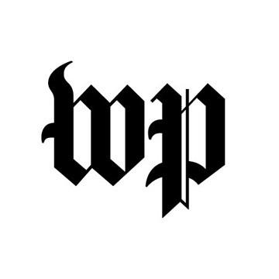
Knight Commission on NCAA Future
College sports: Rethink, reimagine, restructure, rebuild
Sports Business Journal, November 29, 2021
Knight Commission CEO Perko: “We believe Division I needs a new financial framework that requires more funding for the health, education and safety of the athletes and at the same time puts constraints on runaway spending.”
The NCAA is voting on a new constitution. Here’s what that means for college sports fans
Washington Post, November 15, 2021
“Co-Chair Nancy Zimpher characterized the decision over whether to adopt or reject the values central to its model as ‘the clarion designation of whether once and for all we are an academic enterprise as opposed to a commercial enterprise.’”
In a New Constitution, the NCAA Reduces the Power of a Key Player: Itself
Wall Street Journal, November 15, 2021
CEO Amy Perko: "[The new Constitution] puts the future of Division I, everything from revenue distribution to enforcement, in the hands of Division I leaders to define for the future.”
Opportunity for Change
Front Office Sports, November 12, 2021
“…the [NCAA Constitution] draft also gives Division I the actual power to reorganize its budget — so the idea comes just in time. On top of that, the [C.A.R.E.] model has momentum."
FBS schools spent over $533.6M in dead money
ESPN, November 4, 2021
Knight Commission CEO Perko: “This is exactly why we released our 2021 C.A.R.E. model report. If far-reaching steps aren't taken soon to control runaway spending on coaches, hundreds of millions of dollars will just continue to be wasted.”
NCAA rewrites constitution, sets stage for transformation
Associated Press, November 9, 2021
“The Knight Commission recently proposed a revenue-sharing model that it believes would curb the athletics arms race at the top of Division I and better support educational goals.”

