Slide 1
Altering NCAA Revenue Distribution
To Correct for Racial Inequity
Presentation to Knight Commission
May 16, 2022

Slide 2
Purpose statement:
“The purpose of the Knight Commission on Intercollegiate Athletics is to develop, promote, and lead transformational change that prioritizes the education, health, safety and success of college athletes.”

Slide 3
Knight Commission Recommendations (May 2021)
Achieving Racial Equity: Moving from Pledges to Policy
Closing educational opportunity gaps to create an equitable pathway for Black athletes’ success during and after college.
Holding institutions accountable in recruitment and hiring to achieve diversity and equity in athletics leadership.
Investing in programs that support and enhance Black athletes’ college experience and promote inclusion and belonging.
Creating more equitable opportunities for Black athletes to assume leadership roles, especially in advocacy and governance.

Slide 4
Racial Equity Recommendations – Actions Taken To Date
The NCAA should eliminate the standardized test to determine first-year athletics eligibility.
To determine first-year athletics eligibility, the NCAA should implement a holistic evaluation process, based on learning sciences research and best admission practices, that places emphasis on an athlete’s high school academic record, including high school grade point average and satisfactory completion of high school core courses.
Status: In April 2022, the NCAA DI Council introduced legislation into the 2022-23 legislative cycle, recommended by the Committees on Academics, to remove the standardized test score requirement from initial-eligibility requirements. This legislation will be voted on at the Council’s January 2023 meeting.

Slide 5
Racial Equity Recommendations – Actions Taken To Date
The NCAA should require institutions to designate the equivalent of the “senior woman administrator” position to represent the interests of athletes of color.
Status: NCAA Council with support from NCAA Minority Opportunities and Interest Committee and Men’s and Women’s Basketball Oversight Committees advanced a proposal in NCAA Legislative Cycle that requires conferences and institutions to designate a senior minority athletics administrator.
The Knight Commission will fund independent research to examine if institutions with large racial graduation gaps in GSR scores in one or more sports are qualifying for financial awards through the NCAA’s new academic incentive program, and if so, whether the NCAA should institute an additional standard or filter for institutions to receive funding for meeting academic benchmarks.
Status: May 16 presentation of research.

Slide 6
Overview of Financial Incentives tied to Academic Success

Slide 7
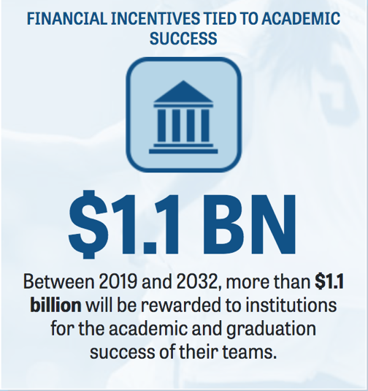
NCAA Academic Performance Fund
Between 2021 and 2032, more than $1.1 billion is dedicated to reward institutions for the academic and graduation success of their teams.
Key Points:
Knight Commission first recommended academic incentives in 2001 with ongoing advocacy until adoption in 2016
$1.1B is a significant allocation for academic success

Slide 8
NCAA Academic Performance Fund Criteria (2016)
Academic Unit is achieved by meeting the benchmark in any ONE of THREE standards
Benchmark based on top quartile of schools in 2015
Utilizes single-year data (not multi-year) and all sports are aggregated with equal weighting for each sport
Thresholds originally selected so that approximately 2/3 of membership achieve an Academic Unit
Academic Progress Rate
(APR)
985
Graduation Success Rate
(GSR)
90%
Federal Graduation Rate
(Student-Athlete vs. Student Body)
13 percentage points higher
for Student-Athlete vs. Student Body
OR
OR

Slide 9
Institutional Academic Performance has Improved
Evaluating by the 75th Percentile
Academic Unit Standard | 75th Percentile 2015 |  | 75th Percentile 2019
GSR | 90% |  | 95%
APR | 985 |  | 989
Federal Graduation Rate (% difference between Student-Athlete & Student Body) | 13% |  | 12%

Slide 10
Institutional Academic Performance has Improved
Number and Percentage of Division I Institutions Qualifying for Each of the Three Standards
Benchmark | 2015 |  |  | 2019
 | # of institutions | % of institutions |  | # of institutions | % of institutions
APR >= 985 | 147 | 42% |  | 188 | 54%
GSR >= 90% | 128 | 37% |  | 189 | 54%
SA-SB Diff >= 13% | 90 | 26% |  | 81 | 23%
Total number of qualifying schools | 243 | 69% |  | 278 | 79%

Slide 11
Gap Between Division I Black and White GSR
All 350 DI Institutions
(all sports)
Gap Between Black and White GSR |  | 2019 | 2019
 |  | # of institutions | % of institutions
Less than 10% |  | 196 | 56%
11-20% |  | 87 | 25%
21-25% |  | 20 | 6%
26-30% |  | 19 | 6%
31-40% |  | 11 | 3%
41-50% |  | 10 | 3%
Greater than 50% |  | 7 | 2%
Example:
In 2019, 56% of all Division I institutions had less than a 10 percentage points gap between Black and White GSR.

Slide 12
What would be the result of a new Racial Equity Standard as a filter to achieve academic units? Racial Equity Standard = A designated maximum percentage point gap between Black and White college athlete Graduation Success Rates (GSR) among qualifying institutions

Slide 13
Impact of a Racial Equity Standard:
A maximum percentage point gap between Black and White college athlete Graduation Success Rates (GSR)
Overall institutions qualified | 2019 | 2019
 | # of institutions | % of institutions
No Racial Equity Standard | 278 | 79%
20% maximum gap | 211 | 60%
25% maximum gap | 231 | 66%
30% maximum gap | 250 | 71%
40% maximum gap | 261 | 75%
If the 25 percentage point maximum gap between Black and White college athlete GSR’s had been applied in 2019, 231 institutions would qualify for the academic unit.
Data should be evaluated on a regular basis (or at least every four years)
Goal is to move toward decreasing the percentage point gap allowed.

Slide 14
Estimated Impact of a Racial Equity Standard by DI Subdivision (2019 data)
DI Subdivision Breakdown | Academic Unit Qualifiers | Estimated Academic Qualifiers using new Standard (25 percentage point gap)
 | % of institutions | % of institutions
FBS | 77% | 63%
Autonomy | 83% | 75%
Non-Autonomy | 71% | 51%
FCS | 77% | 66%
No MFB | 86% | 70%
HBCU | 48% | 48%
Example:
In 2019, 77% of FBS institutions qualified for the Academic Unit. If the Racial Equity Standard had been applied, 63% of FBS institutions would have qualified for the Academic Unit.

Slide 15
A NEW Knight Commission Recommendation
To Improve NCAA Revenue Distribution to Address Racial Equity
Racial Equity Standard:
Gap between Black and White College Athletes is no more than 25 percentage points
First Standard (new)
+ Existing Standards
Academic Progress Rate
(APR)
985
Graduation Success Rate
(GSR)
90%
Federal Graduation Rate
(Student-Athlete vs. Student Body)
13 percentage points higher
for Student-Athlete vs. Student Body
OR
OR
RESULT
INSTITUTION RECEIVES THE ACADEMIC UNIT

